Slide 1

Bon Voyage
Because your travel deserves a well designed database…
Submitted by:
Prof. Simon Wang
Raseswari Das 001259634
Soumya Prateek Adhikaree 001280941
Zixuan Xu 001224785
INFO6210 Data Mgt and Database Design Project

Slide 2


Slide 3
What is Project - Bon Voyage?
Bon voyage is a relational database with 17 entities, 2 multi-table views, 2 computed columns and a data encryption trigger
Bon voyage is a powerful reservation database designed for tour & activity of all sizes, built to bring ease and efficiency to every aspect of your tour
Bon voyage is not just a booking platform for tours & activities in the world. It also lets you DIY your tour, combine comfort rooms with interesting events in the locale. Event organizers can use Bon voyage to represent their detailed information in order to provide the best service for their customers
Bon voyage can guide customers to pick a restaurant based on various information and scores provided by former visitors. Our system aims to limit restaurants/hotels/organizers based on their rating to make sure customers enjoy the services

Slide 4
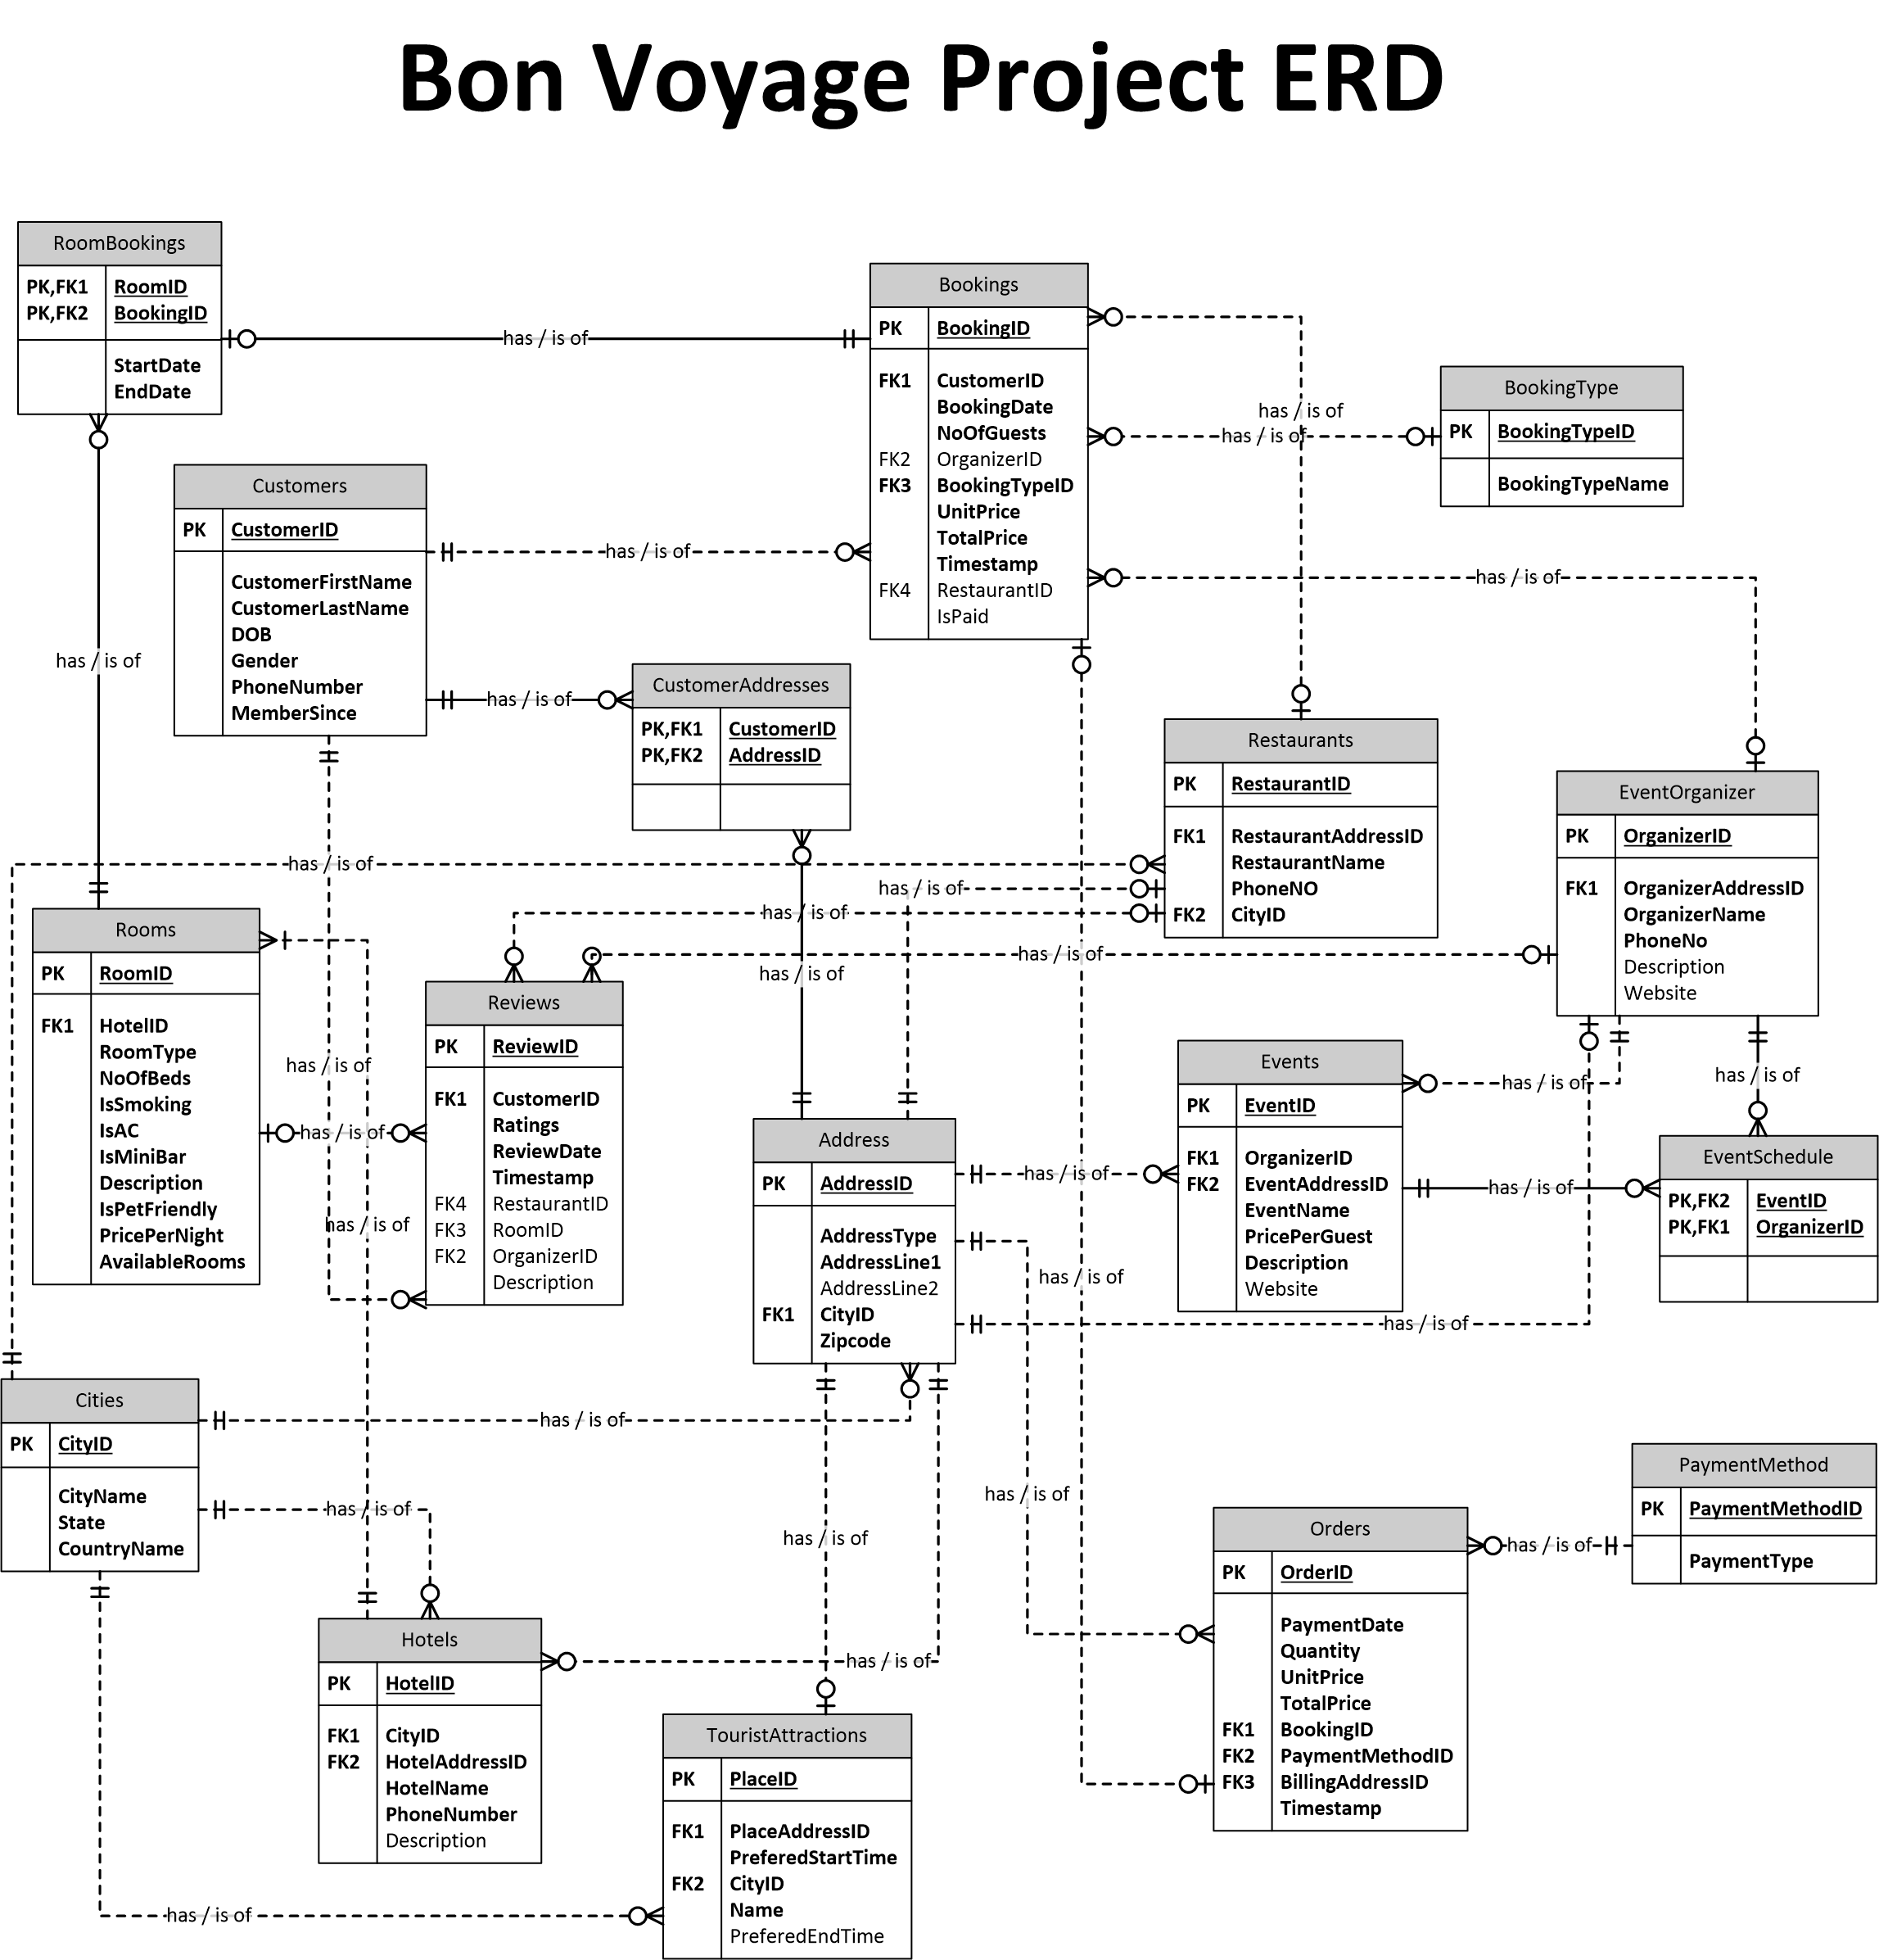

Slide 5
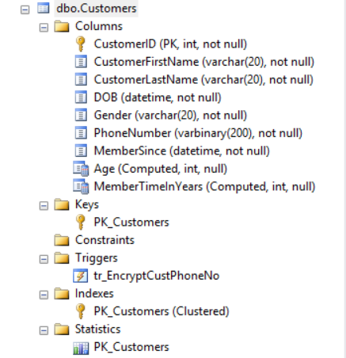
Trigger, data encryption and Computed Columns
Customer Table
Tr_EncryptCustPhoneNo
Computed Customer Age
Computed Member Since (as time in years)

Slide 6
Trigger, data encryption and Computed Column
Computed Cust Age
Computed Member Since
ALTER TABLE [dbo].[Customers] ADD [MemberTimeInYears] AS DATEDIFF(hour,MemberSince,GETDATE())/8766
ALTER TABLE [dbo].[Customers] ADD [Age] AS DATEDIFF(hour,DOB,GETDATE())/8766
Trigger
CREATE TRIGGER [dbo].[tr_EncryptCustPhoneNo] ON [dbo].[Customers] AFTER INSERT AS … UPDATE [dbo].[Customers] SET [PhoneNumber] = (EncryptByKey(Key_GUID(N'TestSymmetricKey'), (SELECT [PhoneNumber] FROM inserted))) WHERE CustomerID=(SELECT CustomerID FROM inserted); …
Data Encryption
-- Create DMK CREATE MASTER KEY ENCRYPTION BY PASSWORD = ’*********’ -- Create certificate to protect symmetric key CREATE CERTIFICATE TestCertificate WITH SUBJECT = 'BonVoyage Test Certificate’ EXPIRY_DATE = '2026-12-31'; -- Create symmetric key to encrypt data CREATE SYMMETRIC KEY TestSymmetricKey WITH ALGORITHM = AES_128 ENCRYPTION BY CERTIFICATE TestCertificate; ……
Decryption
-- Update the table with decrypted names
UPDATE [dbo].[Customers]
SET [PhoneNumber] = DecryptByKey([PhoneNumber]);

Slide 7
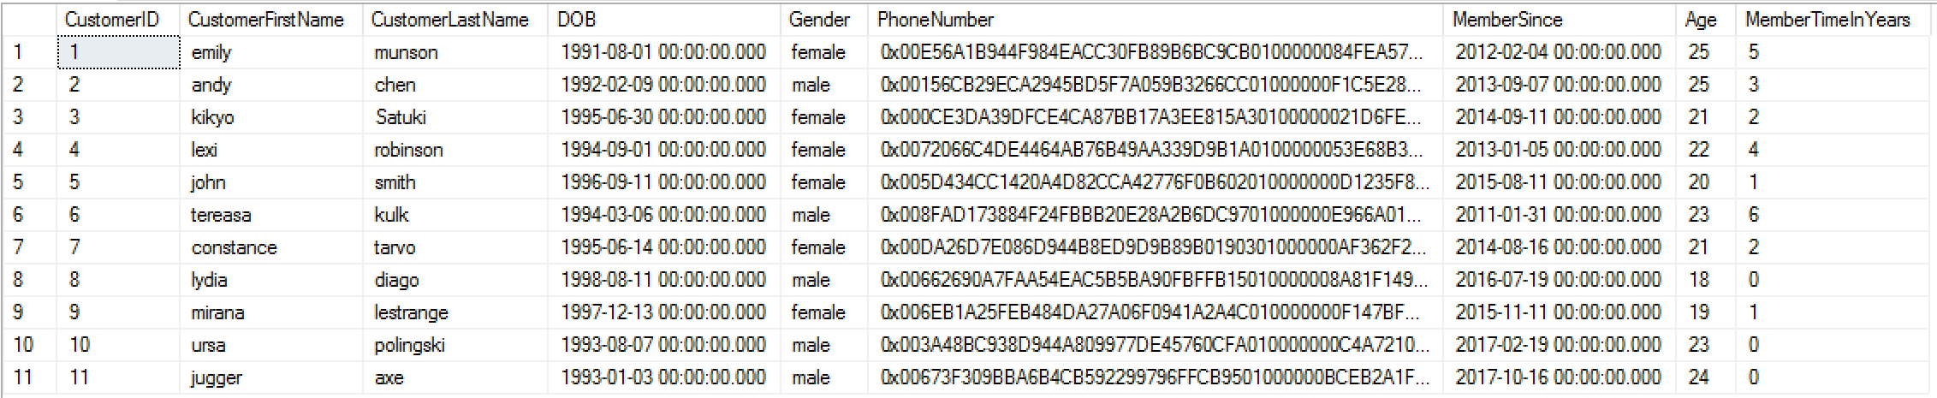
Customer Table

Slide 8
Multi-table Views
vw_EventOrganizerDetails
vw_HotelMaxBooking
Event Organizer
Address
Cities
Hotel
Room
Bookings
Address
AddressID
CityID
AddressID
HotelID
RoomID

Slide 9
Multi-table Views
Top 20 Event Organizers and their details
CREATE VIEW vw_EventOrganizerDetails AS SELECT TOP 20 eo.[OrganizerName], ad.[AddressLine1] AS Address, eo.[PhoneNo], ct.[CityName], eo.[Website] FROM [dbo].[EventOrganizer] AS eo JOIN [dbo].[Address] AS ad ON eo.[OrganizerAddressID] = ad.[AddressID] JOIN [dbo].[Cities] AS ct ON ad.[CityID] = ct.[CityID] ORDER BY [OrganizerName] ASC;
Top 20 Hotels based on Max Bookings
CREATE VIEW vw_HotelMaxBookings AS SELECT TOP 20 h.HotelName, (SELECT CityName FROM Cities city WHERE city.CityID = h.CityID) [CityName], a.AddressLine1 [Address], h.PhoneNumber, (SELECT COUNT(booking.BookingID) FROM [dbo].[RoomBookings] booking WHERE r.RoomID = booking.RoomID) AS 'NumberOfBookings’ FROM [dbo].[Hotels] h, [dbo].[Rooms] r, [dbo].[Address] a WHERE h.HotelID = r.HotelID AND h.HotelAddressID = a.AddressID ORDER BY [NumberOfBookings] DESC;

Slide 10
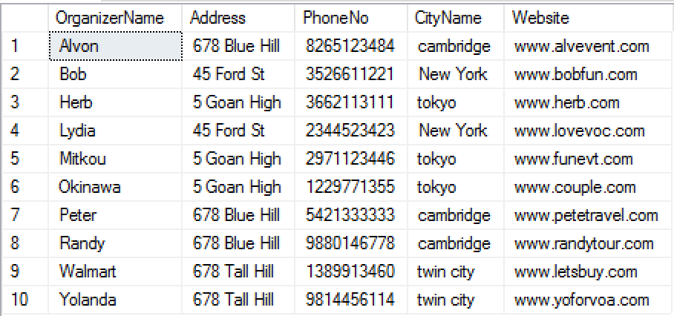
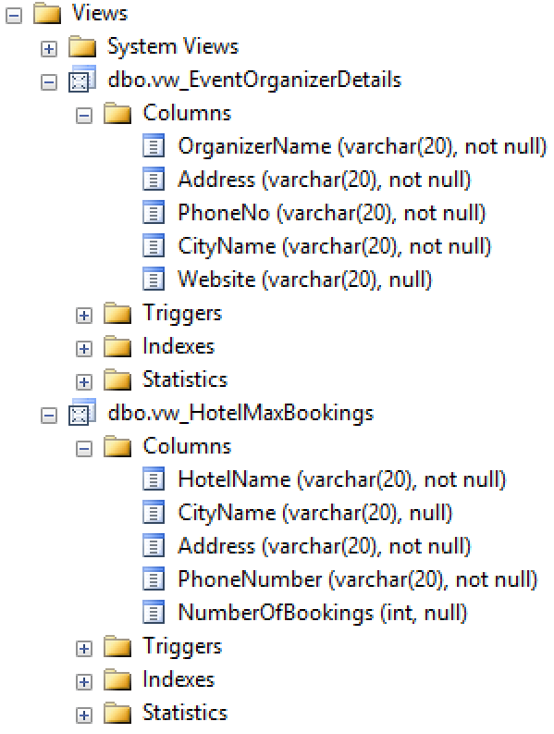
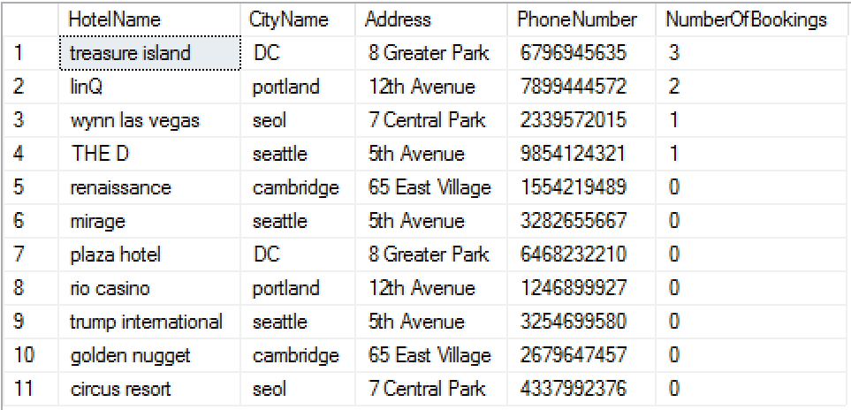
Multi-table Views
vw_EventOrganizerDetails
vw_HotelMaxBookings

Slide 11
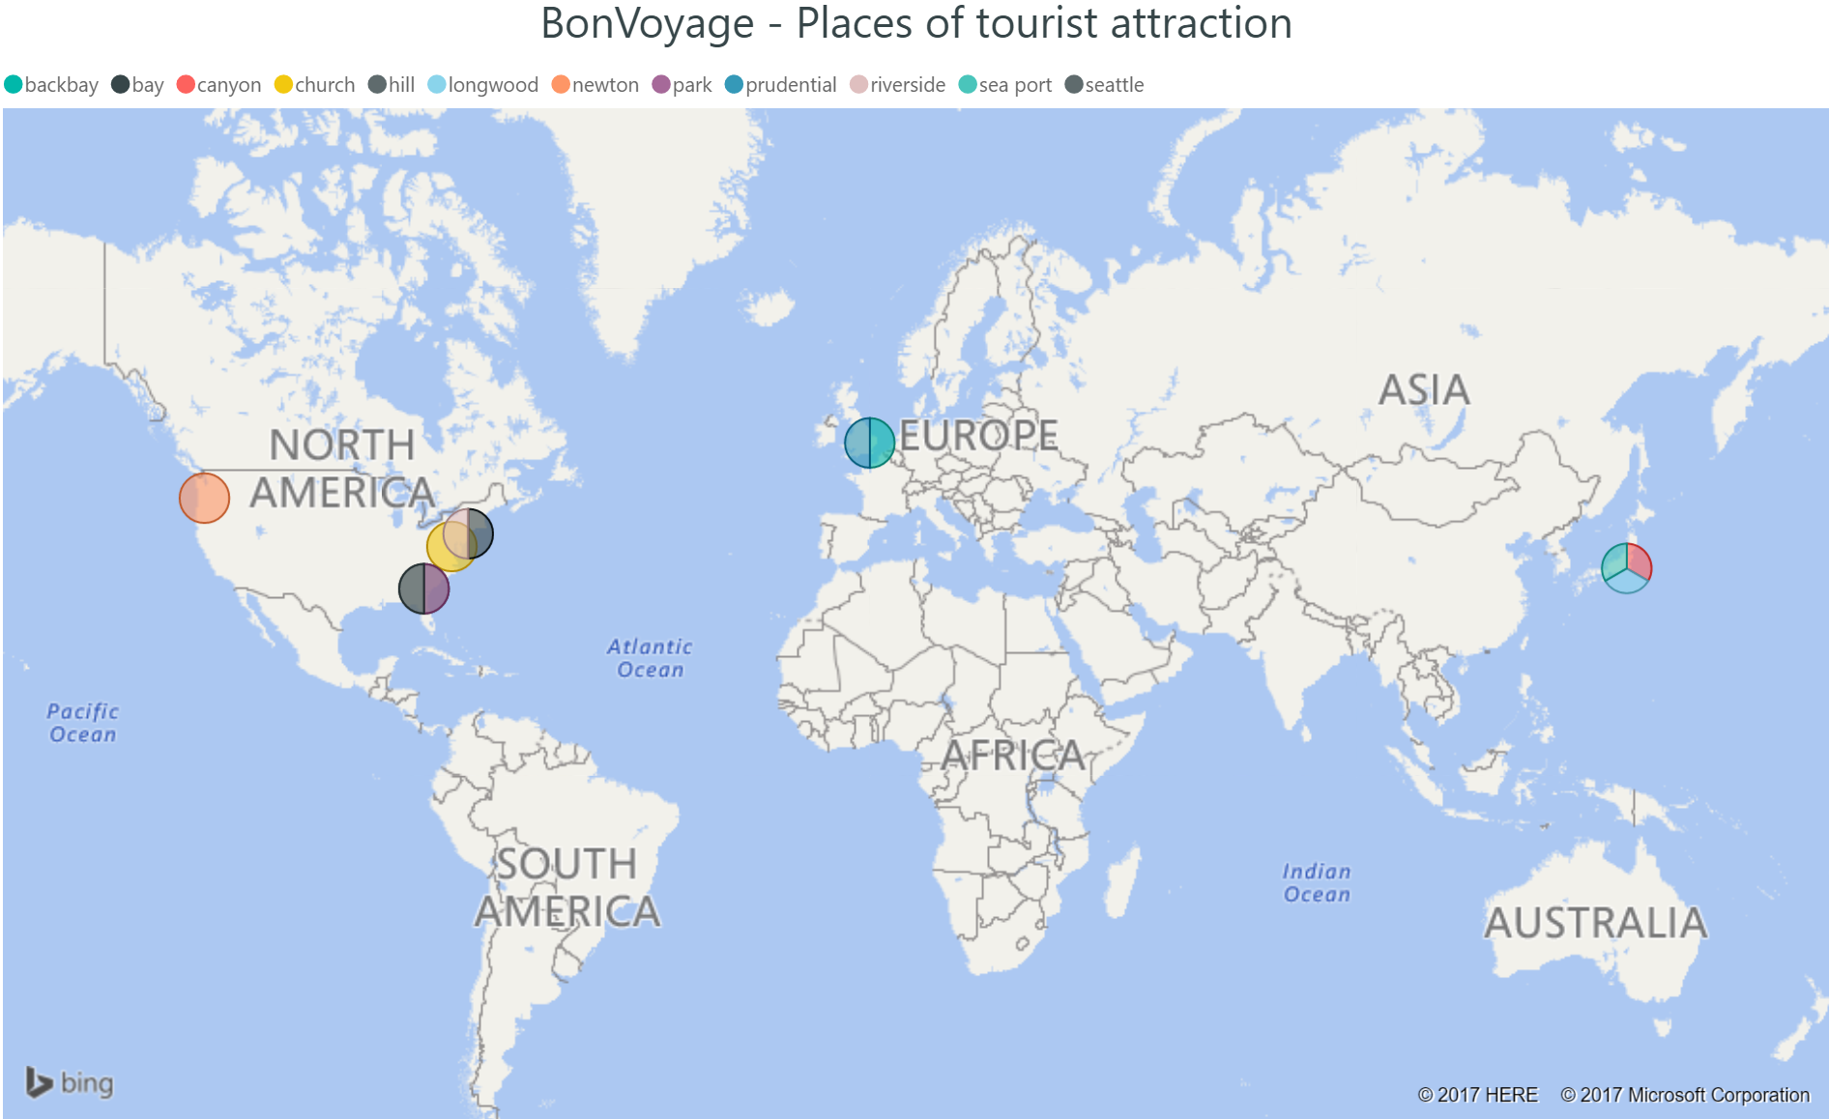
Reports

Slide 12
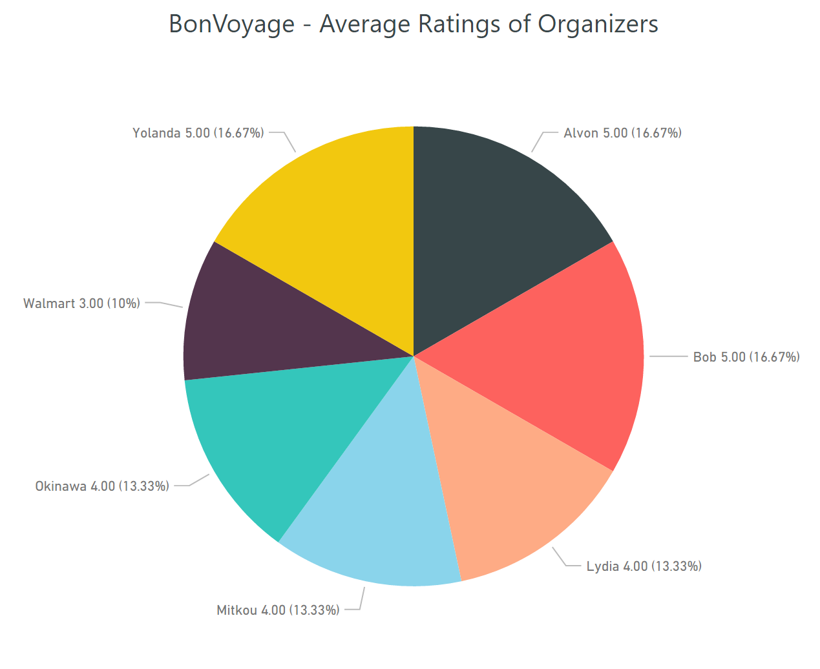
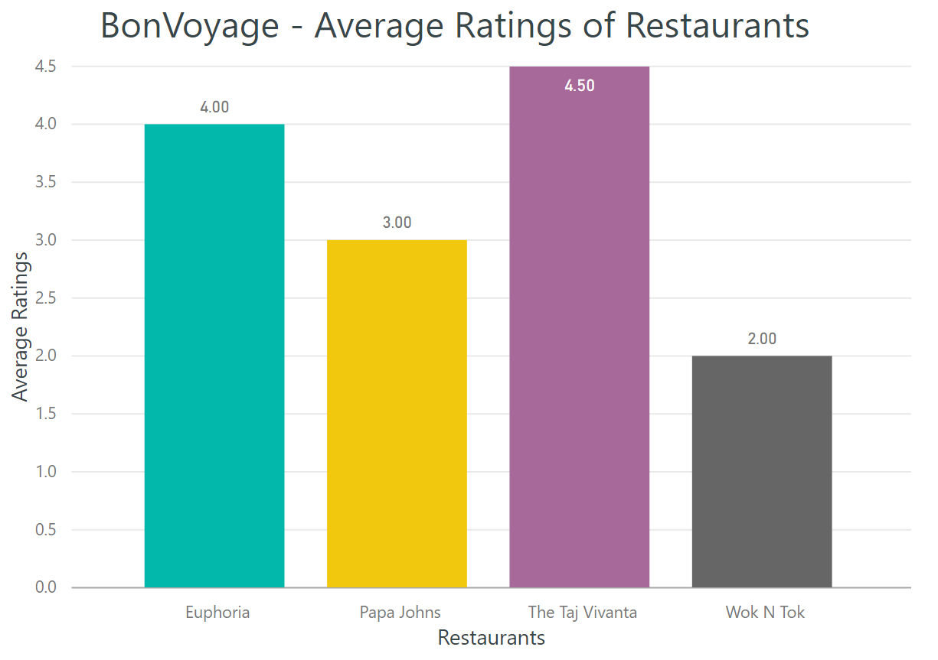
Reports

Slide 13

Thank You!
Until your next vacation beckons….

